Slide 1



ACROPOLIS INSTITUTE OF TECHNOLOGY
AND RESEARCH
CSIT Department
CI Branch
V- Sem
G-Meet Assistant
MINOR PROJECT
PRESENTATION
Submitted by:
Guided by:
Ishvi Garhwal (0827CI191024)
Prakhar Jain (0827CI191044) Sanchit Patidar (0827CI191050)
Prof. Simarjeet Singh Bhatia
Coordinator:
Prof. Nidhi Nigam

Slide 2
PROJECT
IDEA
What is your project idea?
Using features of google meet by voice command.
What does it do?
It will control google meet by voice commands given by the user.

Slide 3
PROJECT
IDEA
How will it work?
If a person wants to operate google meet by voice first they need to install our extension/ application in their chrome browser or system.
Then for using its features by voice command there are some keywords they need to use.

Slide 4
ABSTRACT
As in new age where everyone is using online tools for e-education, there are many students who are handicapped and are facing difficulties as they are depended on someone else to control their online platform.
With the help of this project we will try to help handicapped to use google meet without any external aid. While using this extension which we are creating any user can use basic functions like turning mic or video camera on/off, writing in chat box and even leave meeting just by commanding through voice to their PC.

Slide 5



FEATURES OF
PROJECT
To begin with one can mute or unmute mic using voice command.
In addition to this, they can also turn on or off their video by voice command.
Furthermore, they can open chatbox and write message in it by using voice command.

Slide 6


PROJECT
CATEGORY
Browser Extension
Or
Web application

Slide 7
PROJECT OBJECTIVE
This extension/ utility will control
google meet by voice commands.

Slide 8
PROJECT REQUIREMENTS
(HARDWARE)
Laptop/computer
2 GB RAM (Min recommended)
Hard disk drive/ Solid state drive (min 50 MB space required)
Microphone

Slide 9
PROJECT REQUIREMENTS
(SOFTWARE)
Python interpreter (developer end)
Chrome browser (version- 87.0.4280.141 or above)
Google meet

Slide 10
PROJECT MOTIVATION

Slide 11
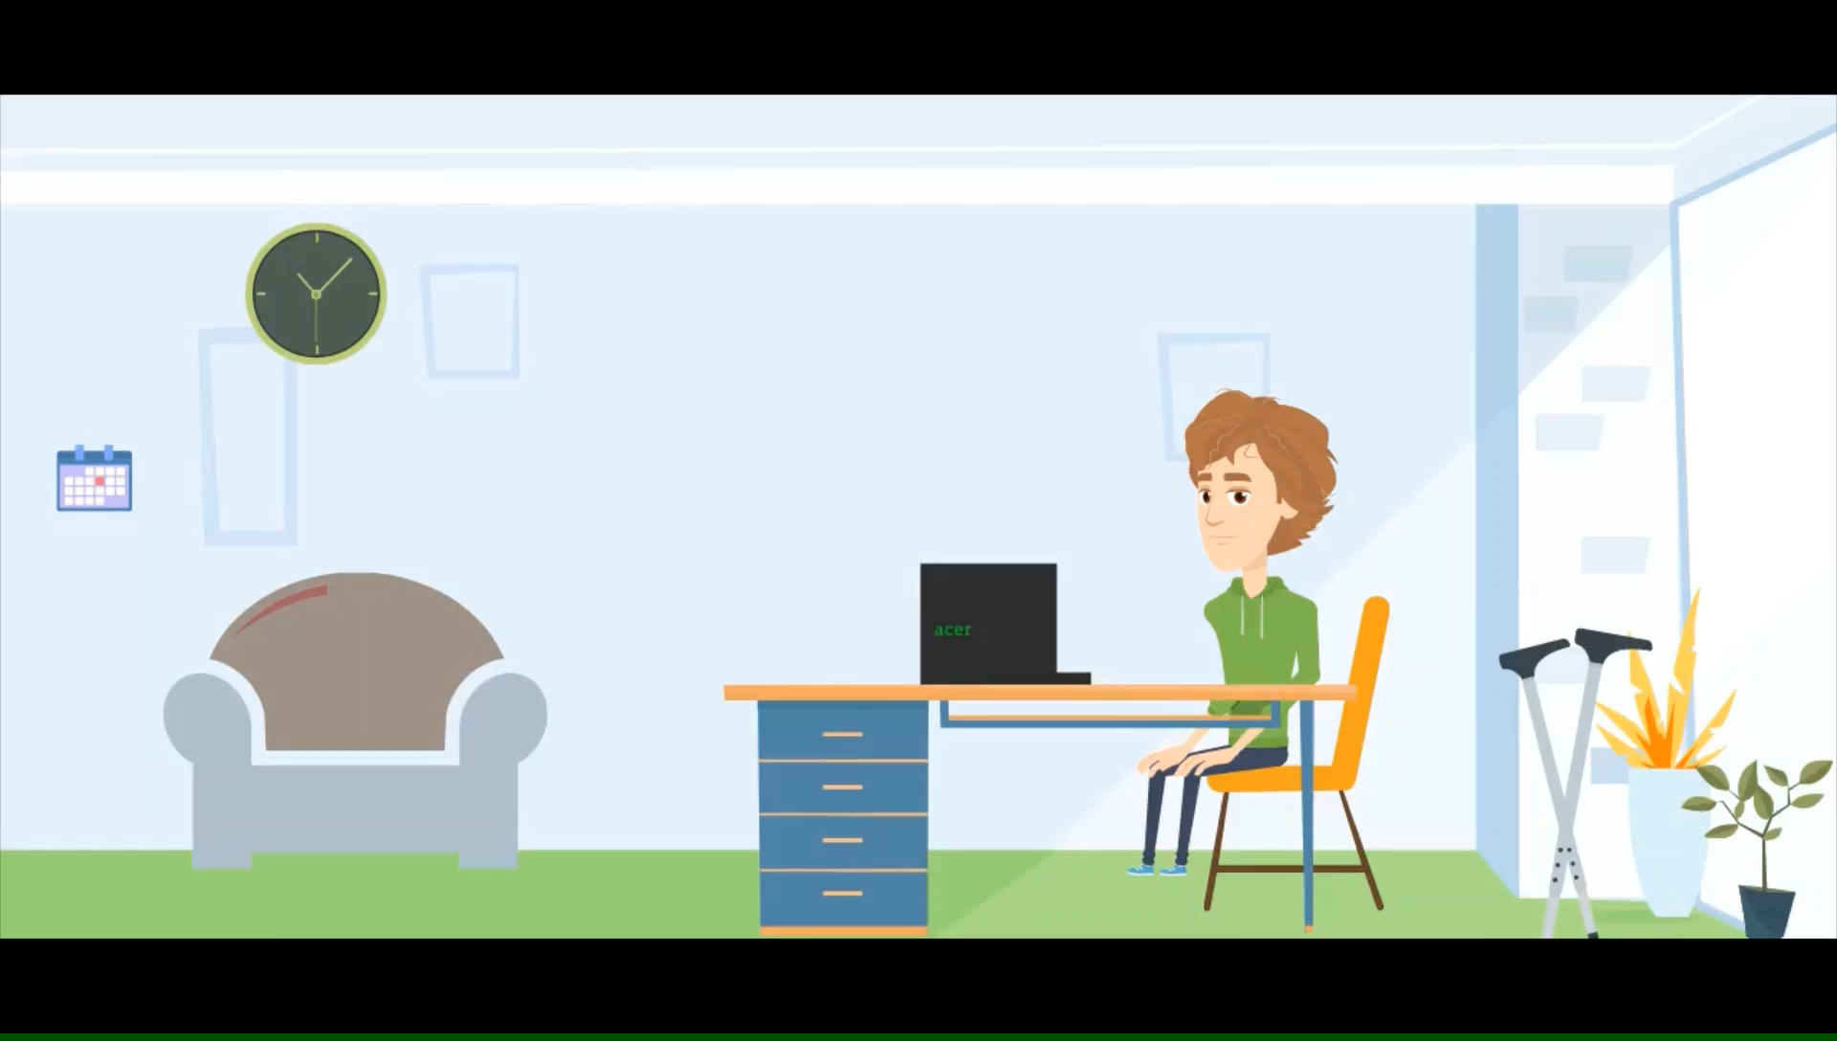

Slide 12
PROJECT MODULES
Speech to text module
Text processing
Functionality
Hosting

Slide 13
Voice input module
Speech to text
Text processing
Voice camera control
Modules
Functionality
Chatbox control
Hosting or releasing
Extension/ GUI

Slide 14
UML DIAGRAMS

Slide 15
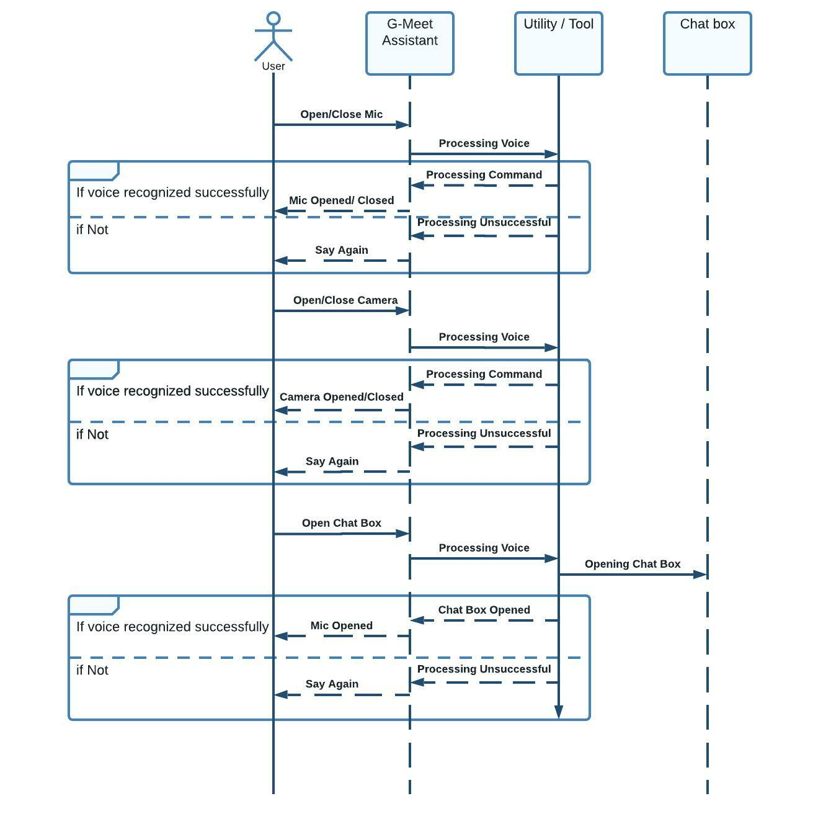
SEQUENCE
DIAGRAM

Slide 16
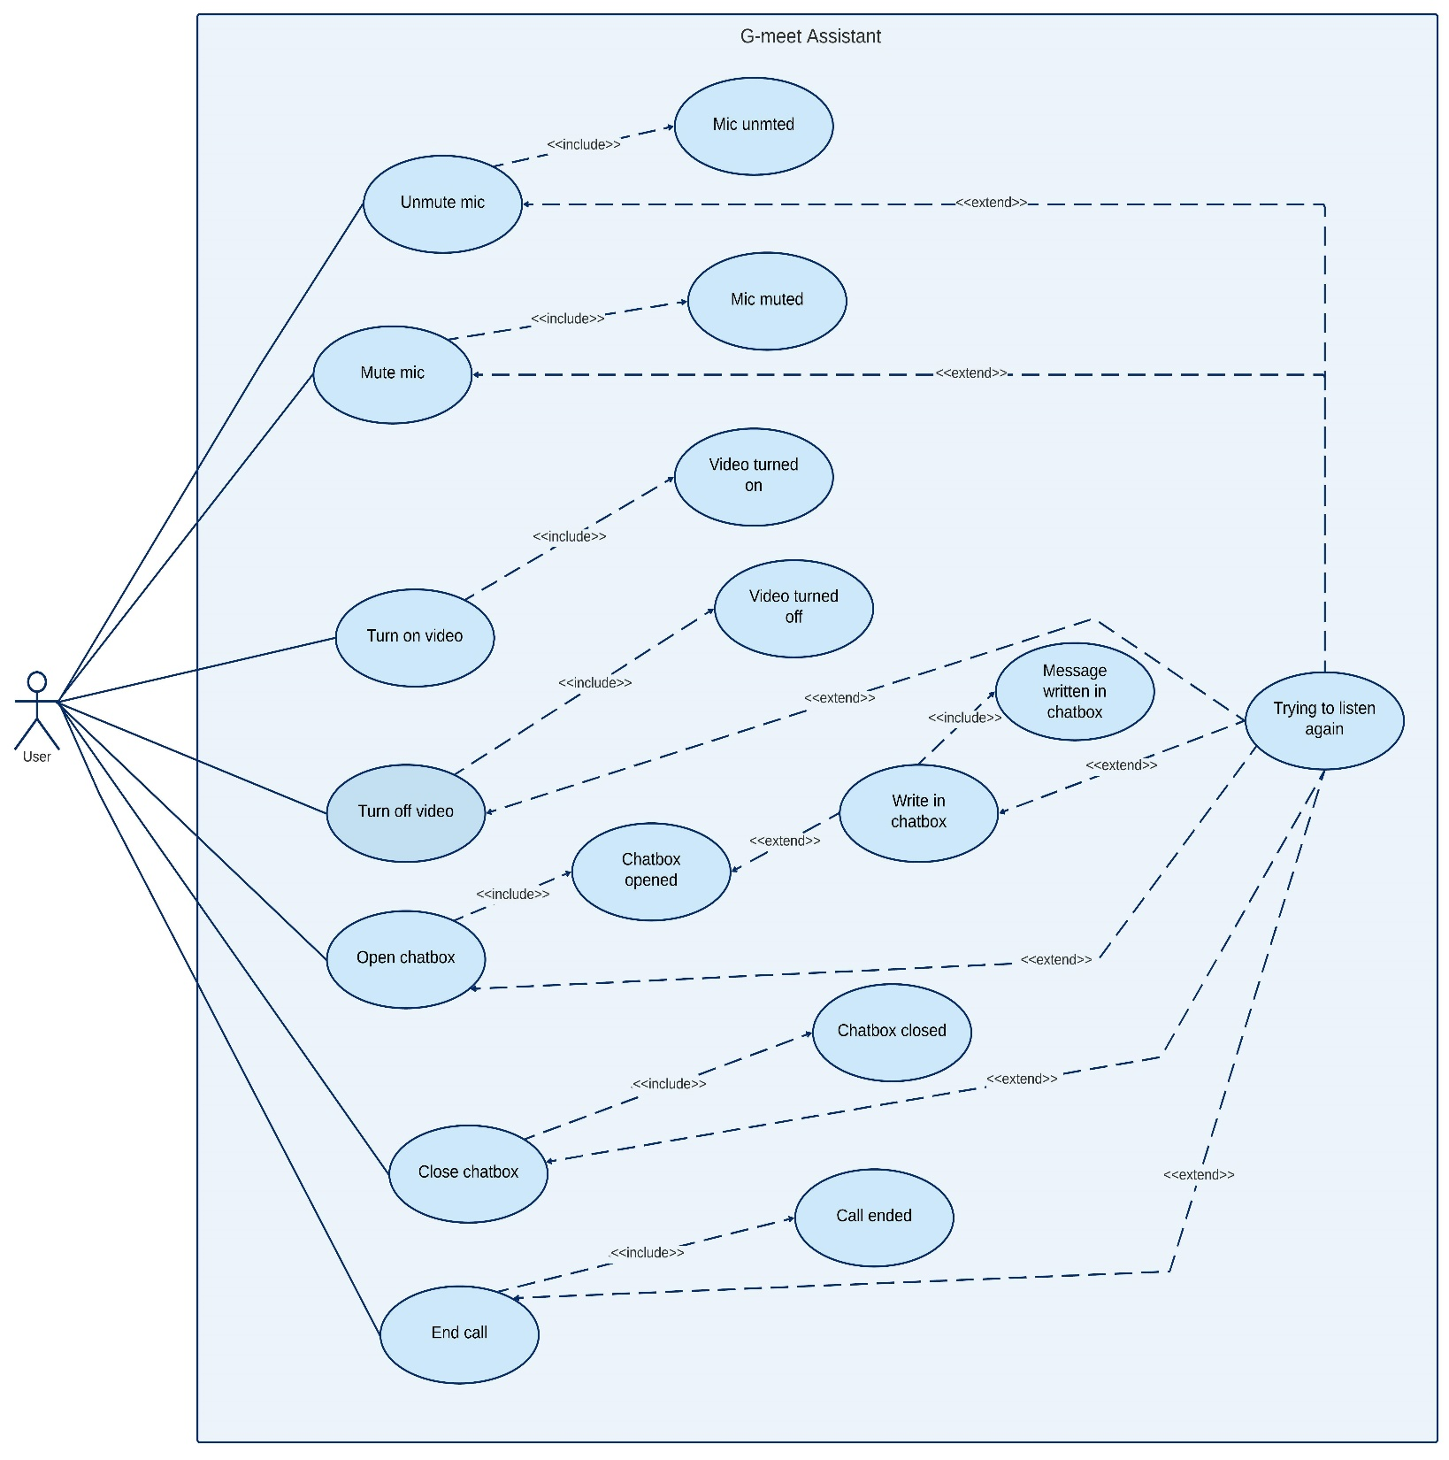
USECASE
DIAGRAM

Slide 17
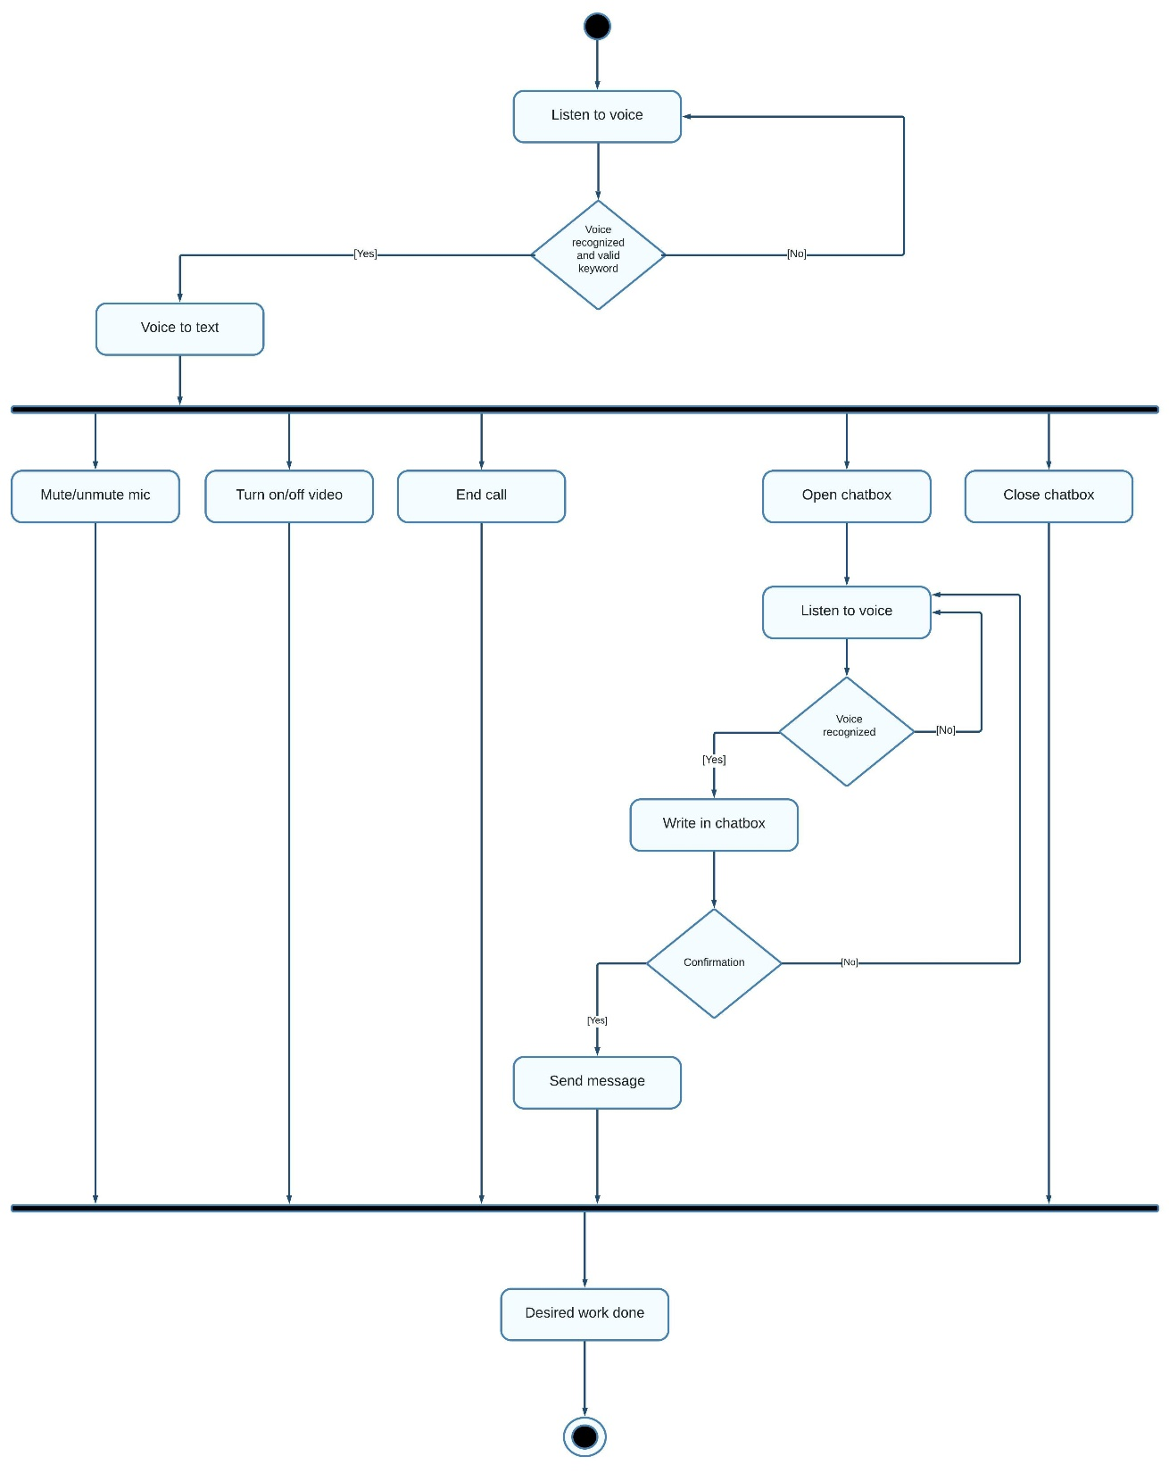
ACTIVITY
DIAGRAM

Slide 18
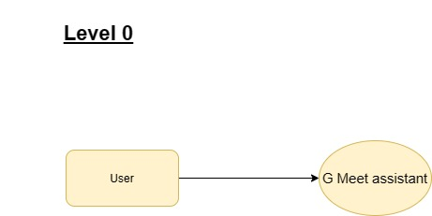
DFD
DIAGRAM
(Level 0)

Slide 19
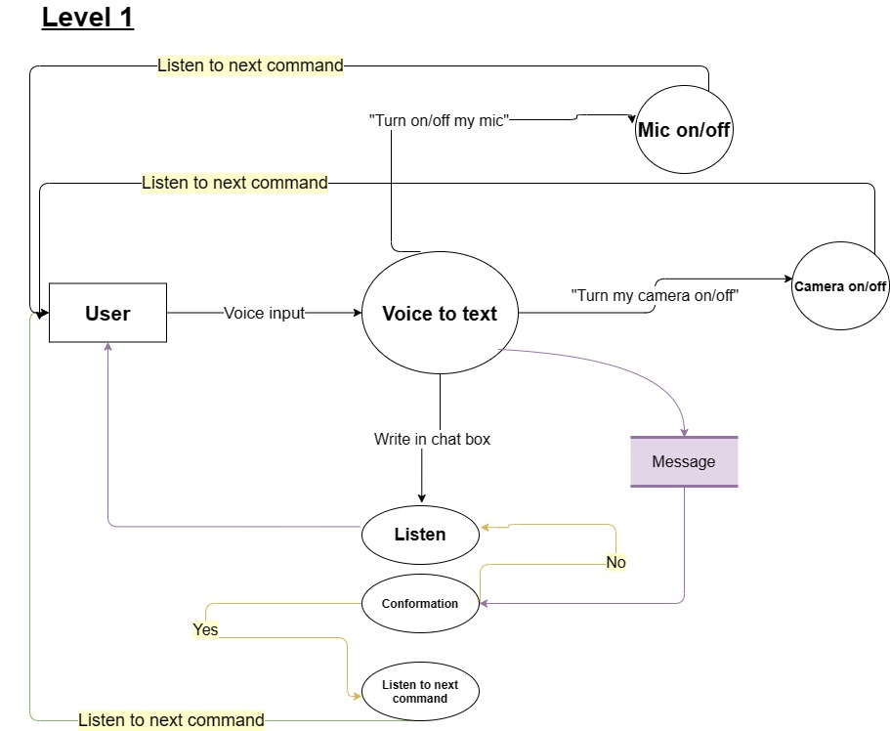
DFD
DIAGRAM
(Level 1)

Slide 20
STAKEHOLDERS
Handicapped/ disabled person.
Any person who is using google meet and can speak

Slide 21
Technical expertise
Ishvi Garhwal
0827CI191024
Prakhar Jain
0827CI19144
Sanchit Patidar
0827CI191050
C, C++,
Python, HTML,
CSS, MySQL,
Flask
C, C++,
Python, HTML,
CSS, JS, Django,
MySQL
C, C++,
Python, HTML,
CSS, JS, ML,
MySQL

Slide 22
Q&A

Slide 23
THANK YOU

